Slide 1
Welcome to Data Visualization of New Stars of Data. We will start shortly

Slide 2
Instructor:
Indira Vadapally

Slide 3
Session Logistics
Say muted in the class for no echo. Raise your hand if need to talk and I will ask by the name to talk.
Please type in the chat window for help if you have any question, so we can take you into breakroom with an instructor to help you
We will have a break every 20 minutes for 5 mins 2 times.

Slide 4
Session Overview
Summary:
Get data into Power BI Desktop (single source, multiple sources)
Perform basic transformation steps and create simple reports

Slide 5
Module - Population Excel File into Power BI Desktop Please follow along the data transformation steps closely File preview( population_solution.pbix)

Slide 6
Module - Web URL data into Power BI Desktop File for preview (web_milwaukee_weather_solution.pbix) Below list gives the get data activity using web URL. -Get data using web URL (https://weather.com/weather/today/l/9ebd644b59b8d94eaffcf072bcabdcc8f34d09c6aa658bffc995bf3d50e4ecf5). -Transform the file contents by selecting relevant data tables, removing top rows, renaming column tables in Power Query Editor. -Present the transformed data in a table format in Power BI canvas area.

Slide 7
Module - Web URI (Uniform Resource Identifier) data using REST API call into Power BI File for preview (ap_starwars_solution.pbix) -Get data using web by using URI (Uniform Resource Identifier) (https://swapi.dev/api/people). -Transform the file contents in Power Query Editor. -Present the transformed data in a table format in Power BI canvas area. -For more information on Star Wars data, refer to following site - https://swapi.dev/documentation#base

Slide 8
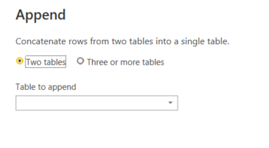
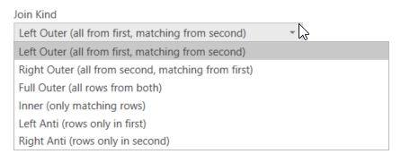
Important concepts- Append Queries and Merge Queries Append – Union of same type of files Use case: Store files of a week Merge – Combine files Use case: different files with same column Merge types:

Slide 9
Module follow along - Objective is to pull data using a file and make a simple report in Power BI. -Upload the "Rental Property Year" file into Power BI -Create a filter for Year to "2019" in Transform process -Apply the changes in Power Query Editor and create a report with all columns in the dataset -Create a slicer for Apartment Type

Slide 10
Let us explore!!

Slide 11
Below are the three labs to work on: LAB1: Objective is to pull data using REST API and make simple report in Power BI. Pull the web Star Wars movie REST API website hosting JSON (particular file format) data of starships in Star Wars movies and complete below tasks. Get data using web URI (https://swapi.dev/api/starships). In Power Query Editor, expand the lists. Present the transformed data of all fields in a table format in Power BI canvas area. For more information on Star wars data, refer to following site - https://swapi.dev/documentation#base ======= LAB2: Objective is to pull data using a file and make a simple report in Power BI. Upload the "Rental Property Year" file into Power BI Create a filter for Year to "2019" in Transform process Apply the changes in Power Query Editor and create a report with all columns in the dataset Create a slicer for Apartment Type ======= LAB3: Objective is to pull data using web URL and make a simple report in Power BI. Pull the web weather.com Chicago, IL weather stats and complete below tasks. Get data using web URL generated by web browser. Transform the file contents by selecting relevant data tables, removing top rows, renaming column tables in Power Query Editor. Present the transformed data in a table format with all columns in Power BI canvas area.

Slide 12
Thank you for joining New Stars of Data!!

